Slide 1

S.G. Highway: Smart Traffic Solutions
 H L College of Commerce (Autonomous)
 Academic Year: 2024-2025
 Presented by:
Krisha Kalathiya MANTHAN M. PATEL
Bhumi Makwana RAHULKUMAR MEENA
Rahi Chuadhari AARIN PANDOR
 Subject: Statistics – X – CE – 304(B)
 Under the guidance of: Dr. Parag shah, Prof. P. M. Parmar & DR. HIREN DOSHI

Slide 2
Brief Overview of S.G. Highway
Importance of S.G. Highway
 Connectively of Ahmedabad-Gandhinagar
 Accident Hotspot
 Traffic Volume
Growing Traffic Concerns
 Rapid urbanization increased vehicle count.
 High congestion levels
 Rising number of private vehicles
Key Issues Identified
 Traffic Congestion
 Accidents
 Environmental Impact

Slide 3
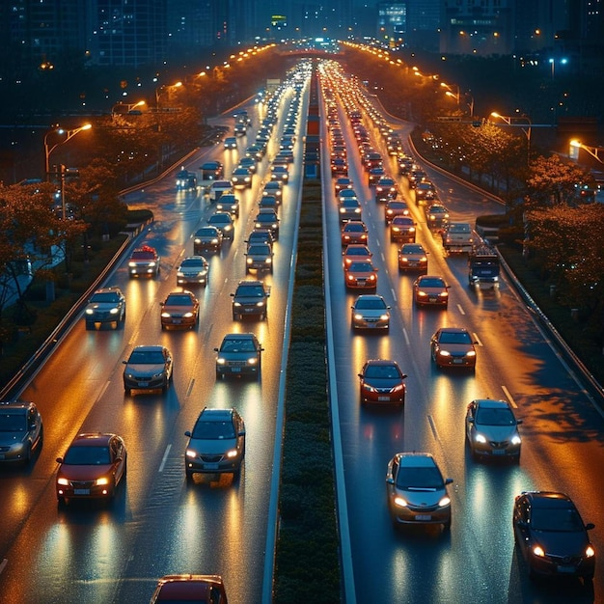
OBJECTIVE OF THE STUDY
Improve traffic flow with smart solution
Enhance Road Safety and Reduce Accidents
Optimize Public Transport Utilization
Access Environmental Impact (Air & Noise Pollution)

Slide 4
METHODOLOGY AND DATA SOURCES
Data Collection Methods
Survey Method
Field Observation
Secondary Data Sources
Sampling Method
Random Sampling
Convenience sampling
Tools used
Google Forms
Manual traffic observation
Excel and statistical tools

Slide 5
Traffic Data & Analysis

Slide 6
Traffic VOLUME
Peak Slot Volume Data:
KEY INSIGHTS
Evening Peak Hours (6-8 PM) records highest traffic of 39.5%
Somnath Chowk is most congested place among the locations with vehicle count of 55,124
Afternoon Traffic suggest reduce movement during time with 28.05%
Morning peak is moderate (32,956 vehicle, 32.52%, primarily driven by office and school commuters
Location | Morning | Afternoon | Evening | Total
Thaltej | 8939 | 7784 | 12521 | 29244
Gurudwara | 5358 | 4512 | 7091 | 16961
Somnath | 1865 | 16125 | 20340 | 55124
Total | 32956 | 28421 | 39952 | 101329

Slide 7
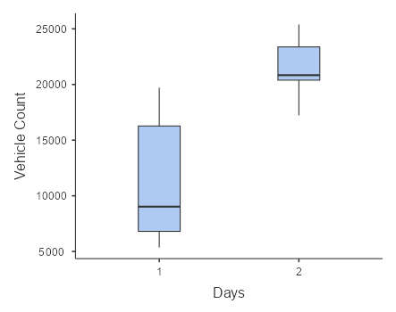
Weekdays vs. Weekend Traffic Patterns
Null hypothesis: There is no significant difference in average traffic volume between weekdays and weekend.
Alternative hypothesis: There is a significant difference in average traffic volume between weekdays and weekend.
 | Days | vehicles count
Mean | weekend | 11314
 | weekday | 21461
Shapiro-Wilk W | weekend | 0.825
 | weekday | 0.949
Shapiro-Wilk p | weekend | 0.098
 | weekday | 0.732
Here p value for both group is greater than 0.05, We conclude that traffic volume for weekdays and weekends is normally distributed.
Here p value less than 0.05, We conclude that variances are not equal.
Homogeneity of Variances Test (Levene's)
 | F | df | df2 | p
vehicles count | 6.07 | 1 | 10 | 0.033
 |  | Statistic | df | p
Vehicle count | Welch's t | -3.58 | 7.06 | 0.009
p= 0.009<0.05, we reject null hypothesis
Therefore, there is a significant difference in traffic volume between weekdays and weekend.

Slide 8
Peak Hour Congestion Patterns
Morning vs. Evening Peak Hour Trends
Null hypothesis: There is no significant difference between morning and evening peak hour traffic congestion.
Alternative hypothesis: There is significant difference between morning and evening peak hour traffic congestion.
 | Morning Traffic volume | Evening Traffic Volume
Mean | 32631 | 32919
Median | 34505 | 33065
Standard deviation | 8523 | 6355
Minimum | 23327 | 26492
Maximum | 40062 | 39200
Shapiro-Wilk W | 0.964 | 1.000
Shapiro-Wilk p | 0.634 | 0.962
Here p value for Two group is greater than 0.05, We conclude that traffic volume for morning and evening is normally distributed.
 |  |  | Statistic | Df | P
Morning | Evening | Student's | -0.199 | 2.00 | 0.861
Here p-value > 0.05 for all variable hence we fail to reject null hypothesis.
This means is no significant difference between morning and evening peak hour traffic volume.

Slide 9
Comparison of Peak Hours Congestion Patterns Across Three Circles
Null hypothesis: There is no significant difference between traffic congestion among the three circles.
Alternative hypothesis: At least one of the circles has a significantly different traffic congestion level.
Normality Test (Shapiro-Wilk)
 | W | P
Traffic Volume | 0.986 | 0.977
Here p value for three group is greater than 0.05, We conclude that traffic volume for morning and evening is normally distributed.
Homogeneity of Variances Test (Levene's)
 | F | df1 | df2 | P
Traffic Volume | 1.04e+31 | 2 | 3 | <.001
Here p value less than 0.05, We conclude that variances are not equal.
One-Way ANOVA (Welch's)
 | F | df1 | df2 | P
Traffic Volume | 41.2 | 2 | 1.72 | 0.035
Here p- value (0.035) < 0.05 for all variable hence we reject null hypothesis.
This means is a significant difference in traffic volume across the different groups.

Slide 10
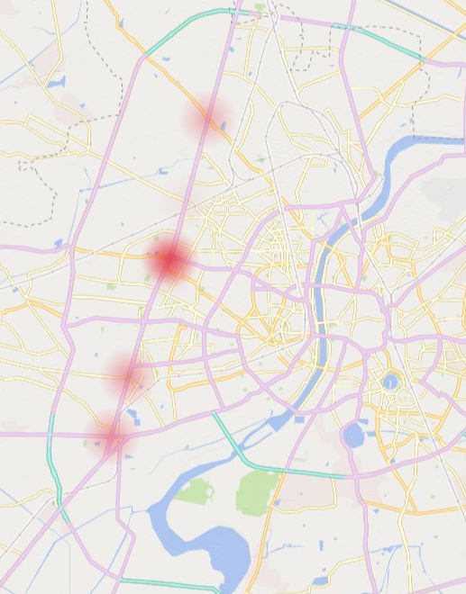
Accident Statistics & Black Spots:
Chandlodiya
25
• INSIGHTS
Thaltej Circle is most accident-prone area, with the highest total accidents, injury accidents, and property damage accident.
Despite having fewer total accident, Chandlodiya and Gurudwara Circle have a higher proportion of fatal accident compared to other location
Injury accidents are the most common type of accident across all location accounting for more than half of all accidents.
Thaltej Circle
43
Gurudwara Circle
22
Karnavati
35
Ahmedabad
Sanand Cross Road 35
25

Slide 11
Public Transport Utilization
Public Transportation Use by Age Group and Gender
• KEY OBSERVATION:
The 18-25 age group constitutes the largest share of public transport users, indicating strong reliance among students and young professionals
Male passengers account for 59% of public transport users, while female passengers constitute 41%.
It indicates improving gender representation but also highlights the need for more gender-friendly initiatives.
3
7
14
27
125

Slide 12
Chi-Square Test
Null Hypothesis : There is no association between age group and transportation mode.
Alternative Hypothesis : There is an association between age group and transportation
Contingency Tables
χ² Tests
 | Transportation
Age Group | Public Transit | Four-Wheeler | Two-Wheeler | Total
Young-Teen | 139 | 47 | 92 | 278
Middle Aged | 27 | 18 | 23 | 68
Senior | 10 | 5 | 5 | 20
Total | 176 | 70 | 120 | 366
 | Value | df | p
χ² | 4.61 | 4 | 0.329
N | 366
p-value greater than 0.05 would indicate we fail to reject the null hypothesis.
Thus, there’s no significant association between age group and transportation mode.

Slide 13
Public Perception and Traffic Congestion
Usage of Government Vehicles
Connected to Highway
Overflow of Vehicle
More people near Mall and Metro Station
Road Design Issue
Causes of Congestion:
Cause | % of Respondents
Over flow of vehicles | 70.7%
More Public near Mall and Metro station | 42.3%
Connected to highway | 21.5%
Road Design Issues | 18.5%
Usage of Government Vehicles | 0.8%
Increase in Travel Time
Increased Fuel Consumption
Risk of Accident
Misses appointment & Events
Stress and Fatigue
Impact on Daily Life
Impact on Daily Life:
Impact Type | % of Respondents
Increase in Travel Time | 75.4%
Stress and Fatigue | 61.0%
Increased Fuel Consumption | 41.0%
Risk of Accident | 36.2%
Missed Appointments/Events | 16.2%

Slide 14
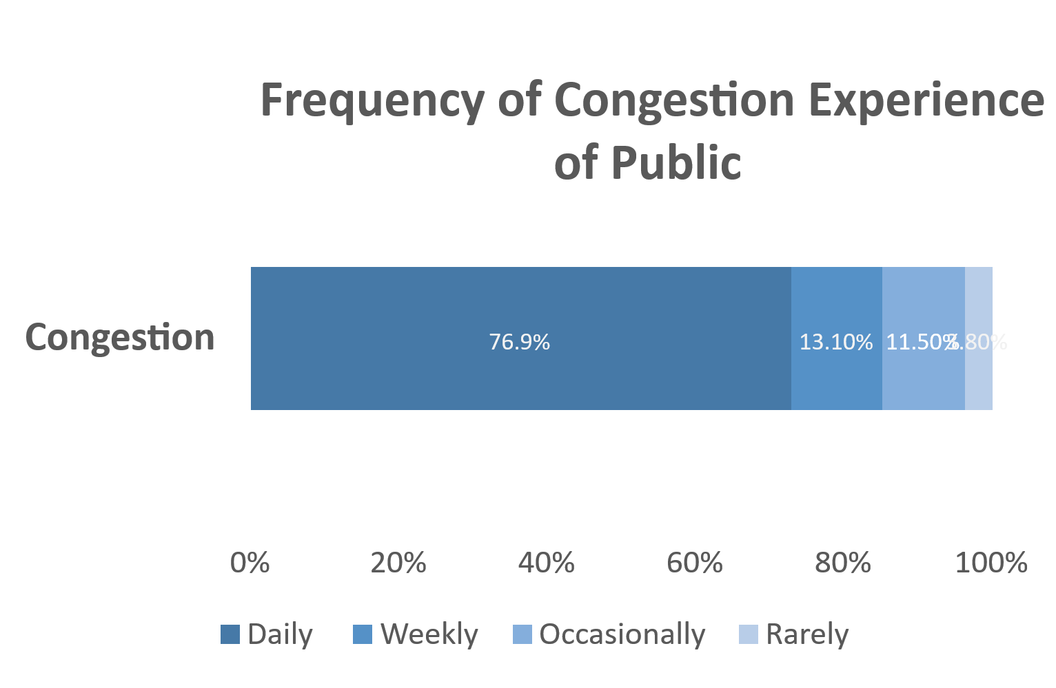
Frequency of Congestion Experience:
Response Type | % of Respondents
Daily | 76.9%
Weekly | 13.1%
Occasionally | 11.5%
Rarely | 3.8%
Mode of Transportation Usage by Occupation
Occupation | Four Wheelers | Two wheelers | Auto rikshaws | Total
Housewife | 0 | 1 | 1 | 2
Professional | 7 | 8 | 2 | 17
Business | 10 | 14 | 3 | 27
Pvt. or Govt. job | 16 | 31 | 11 | 58
Student | 33 | 61 | 29 | 123
Total | 66 | 115 | 46 | 227

Slide 15
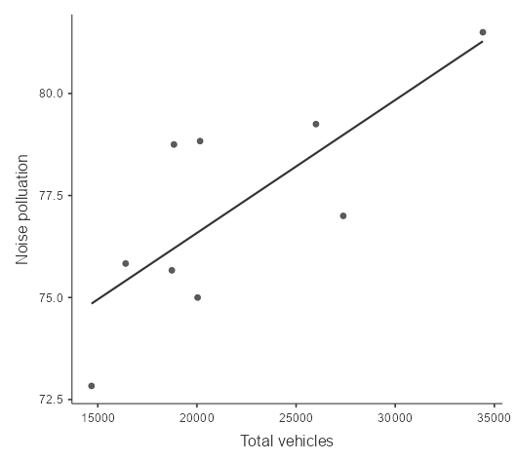
Air Pollution And Noise Levels (AQI Analysis)
Correlation between traffic volume and Noise pollution:
Null Hypothesis: There is no significant correlation between Traffic Volume and Noise Pollution.
Alternative Hypothesis: There is a significant positive correlation between Traffic Volume and Noise Pollution.
Correlation Matrix
 |  | Traffic volume | Average of Noise Pollution
Traffic volume | Pearson's r | —
 | Df | —
 | p-value | —
Average of Noise Pollution | Pearson's r | 0.769 | —
 | Df | 7 | —
 | p-value | 0.015 | —
Here p-value <0.05 hence we reject null hypothesis.
This indicates that there is a statistically significant positive correlation between traffic volume and noise pollution along S.G Highway Ahmedabad.
.

Slide 16
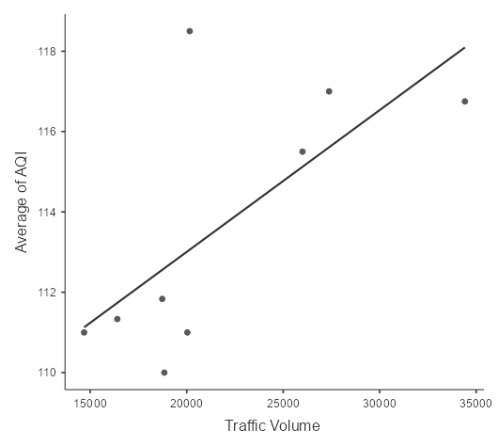
Correlation Between AQI (Air Quality Index) and Traffic Volume
Null Hypothesis: There is no significant correlation between the Traffic Volume and Average AQI.
Alternate Hypothesis: There is a significant correlation between the Traffic Volume and Average AQI.
Correlation Matrix
 |  | Traffic Volume | Average of AQI
Traffic Volume | Pearson's r | —
 | Df | —
 | p-value | —
Average of AQI | Pearson's r | 0.681 | —
 | Df | 7 | —
 | p-value | 0.044 | —
Here p-value <0.05 hence we reject null hypothesis.
This scatter plot shows a positive correlation between traffic volume and average AQI. As traffic volume increases, air pollution levels (AQI) also rise. This indicates that higher vehicle counts contribute to deteriorating air quality on SG Highway.

Slide 17
Analysis of Conventional and Electric Vehicles
Null Hypothesis: There is no association between gender (Male vs. Female) and vehicle type (Conventional vs. Electric).
Alternative Hypothesis : There is an association between gender and vehicle type.
Contingency Tables
Electric Vehicle
Convetional Vehicle
 | Gender
Vehicle Type | Male | Female | Total
Conventional | 87 | 64 | 151
Electric | 19 | 8 | 27
Total | 106 | 72 | 178
15%
χ² Tests
85%
 | Value | df | p
χ² | 1.55 | 1 | 0.214
N | 178
Since the p-value (0.214) is greater than 0.05, we fail to reject the null hypothesis. This means that there is no statistically significant evidence to conclude that males and females have different preferences between conventional and electric vehicles based on the collected data.

Slide 18
TRAFFIC MANAGEMENT STRATEGIES
Smart Traffic Management
Intelligent Traffic Signals – AI-based signal optimization.
Real-time Traffic Monitoring – CCTV & IoT-based congestion tracking.
Public Transport Enhancements
Bus Expansion – Improve accessibility & frequency.
Digital Ticketing & Real-Time Tracking – For smoother commutes.
Expected Impact
Reduced congestion & faster commutes.
Enhanced public transport efficiency
Lower dependency on private vehicles.

Slide 19
Public PROBLEMS
   Key Issues Identified:
    Over flow of vehicles
    More public near Mall and Metro Station
    Connection of Highway
   What Pubic Needs?
  Quality Road infrastructure
  Better Transportation
  Safe Driving
  Impact on Daily life
  Increase in Time Travell
  Stress and Fatigue
  Increase fuel Consumption
   How to Reduce traffic congestion:
  Make Pedestrian Infrastructure
  Better Traffic Management System
  Public Understanding

Slide 20
Road Safety & Sustainability Measures
Road Safety Improvement
Better Road Design – Dedicated lanes, pedestrian zones
Speed Monitoring & Law Enforcement – AI cameras & strict penalties.
Accident-Prone Area Fixes – Black spot identification & improvements.
Environmental Sustainability
Promote Electric Vehicles (EVs) – Incentives & charging stations.
Increase Green Spaces – Roadside trees & urban forests.
Encourage Cycling & Walking – Dedicated lanes & safer sidewalks.
Expected Impact
Safer roads & reduced accident rates.
Healthier environment & lower emissions.
Enhanced quality of urban life.

Slide 21
Expected Outcomes & Benefits
  Traffic Flow Improvements
  Road Safety Enhancements
  Public Transport Utilization Growth
  Environmental & Health Benefits
  Economic & Social Impact

Slide 22
Conclusion & Recommendations
Conclusion:
The study highlights the pressing need for traffic management interventions on S.G. Highway.
Congestion, accidents, and pollution remain critical challenges requiring immediate action.
Integrating technology-driven solutions can significantly enhance urban mobility and safety.
Recommendations:
✅ Improve intersection design
✅ Enhance safety measures at black spots
✅ Enforce traffic rules.
✅ Public awareness campaigns
Final Thought: By adopting these strategies, S.G. Highway can evolve into a well-managed, efficient, and eco-friendly transportation corridor, improving the overall urban experience for commuters and residents alike.

Slide 23
References
Research Paper:
Traffic Management Systems - A Review" by S. S. Iyer et al. (2018)
Intelligent Traffic Management System Using IoT and Big Data Analytics - A. K. Singh et al. (2020)
Traffic Congestion Mitigation Using Real-Time Traffic Signal Control - Y. Zhang et al. (2019)
Books:
Traffic Management and Traffic Engineering" by Michael D. Meyer (2018)
Intelligent Transportation Systems: Smart and Green Infrastructure Design" by Lei Zhang (2020)
Traffic Flow Theory: Characteristics, Modeling, and Simulation" by R. Akçelik (2017)
Online sources & Conferences

Slide 24
Acknowledgments
We extend our gratitude to:
H L College of Commerce (Autonomous) – for academic support.
Dr. Parag Shah, Prof.P.M.Parmar & Dr. Hiren Doshi – for their valuable guidance.
Survey Participants & Commuters – for their valuable responses.

Slide 25
Thank you
Presented by: T.Y. B.COM
H L College of Commerce (Autonomous)
Thank You for Your Attention!
Any Questions? Feel Free to Ask!

